Slide 1
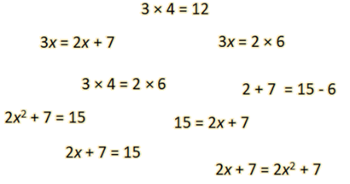
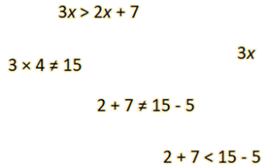
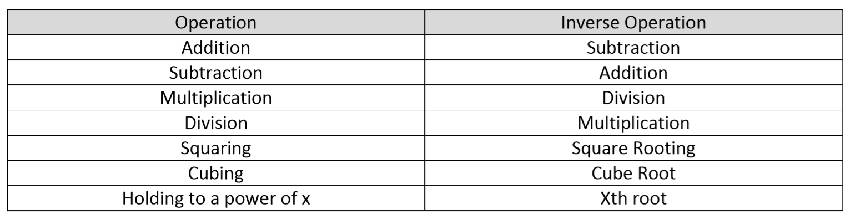

Subtopic 1A – Solving Equations (RECAP)
LEARNING OUTCOME: How to solve equations with One Variable
Keywords:
Equations
Solving
Inverse operations
Substitution
Variables
Objectives:
To understand what an equation is
To become fluent in methods for solving equations
Introduction to Solving Equations:
Equations are a mathematical statement that two things are equal.
You could see this with an example of an equation $1+3=4$ where the value on the left-hand side of the equation is exactly the same as on the right-hand side of the equation.
Equations in your maths lessons will more usually be in an algebraic form, that is they will contain
variables which represent unknown numbers (in fact, mathematicians sometimes refer to these
variables as “unknowns”).
Generally, our challenge will be to work out the value of the variable by solving.
The simplest equations can be thought of as ‘word problems’. For example, the equation, $x+7=10$
can be thought of as “There is an unknown number, and when you add 7 to it, you get 10.”
This means that the unknown number must be $3.$ In this case, we have solved the equation when we
write $x=3$.
You have probably been solving equations for a long time without really realising it. Look at the
examples below:
I think of a number. I double it and get 12. What number was I thinking of?
I think of a number. I subtract 5 from it and I get 15. What number was I thinking of?
I think of a number. I multiply it by 3 and I get 33. What number was I thinking of?
These kinds of problems can often be done in our heads using inverse operations. This idea can still
be used when the equations get more challenging.
Examples
Non - Examples
Inverse Operations
An inverse operation is the opposite operation that ‘undoes’ the first operation.

Slide 2
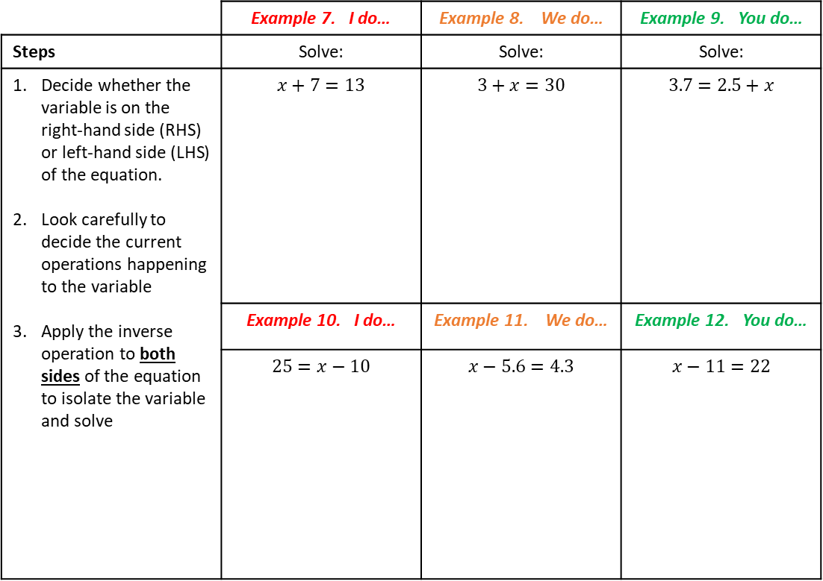
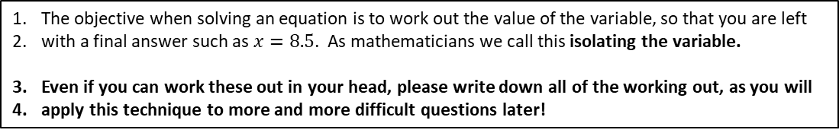
 | Example 1. I do… | Example 2. We do… | Example 3. You do…
Steps | Fill in the gaps: | Fill in the gaps: | Fill in the gaps:
Use your knowledge of operations to work out the relevant inverse operation | “The inverse of adding 7 to a number is ___________ ___________________” | “The inverse of dividing by 9 is ___________ ___________________” | “The inverse of subtracting 8 from a number is ______ ___________________”
 | Example 4. I do… | Example 5. We do… | Example 6. You do…
 | “The inverse of subtracting 4 from a number is ______ ___________________” | “The inverse of multiplying by 11 is ___________ ___________________” | “The inverse of squaring a number is ___________ ___________________”
Solving One-Step Equations
One-Step Equations: Addition and Subtraction
The objective when solving an equation is to work out the value of the variable, so that you are left
with a final answer such as $x=8.5$. As mathematicians we call this isolating the variable.
Even if you can work these out in your head, please write down all of the working out, as you will
apply this technique to more and more difficult questions later!
 | Example 7. I do… | Example 8. We do… | Example 9. You do…
Steps | Solve: | Solve: | Solve:
Decide whether the variable is on the right-hand side (RHS) or left-hand side (LHS) of the equation. Look carefully to decide the current operations happening to the variable Apply the inverse operation to both sides of the equation to isolate the variable and solve | $$x+7=13$$ | $$3+x=30$$ | $$3.7=2.5+x$$
 | Example 10. I do… | Example 11. We do… | Example 12. You do…
 | $$25=x−10$$ | $$x−5.6=4.3$$ | $$x−11=22$$

Slide 3
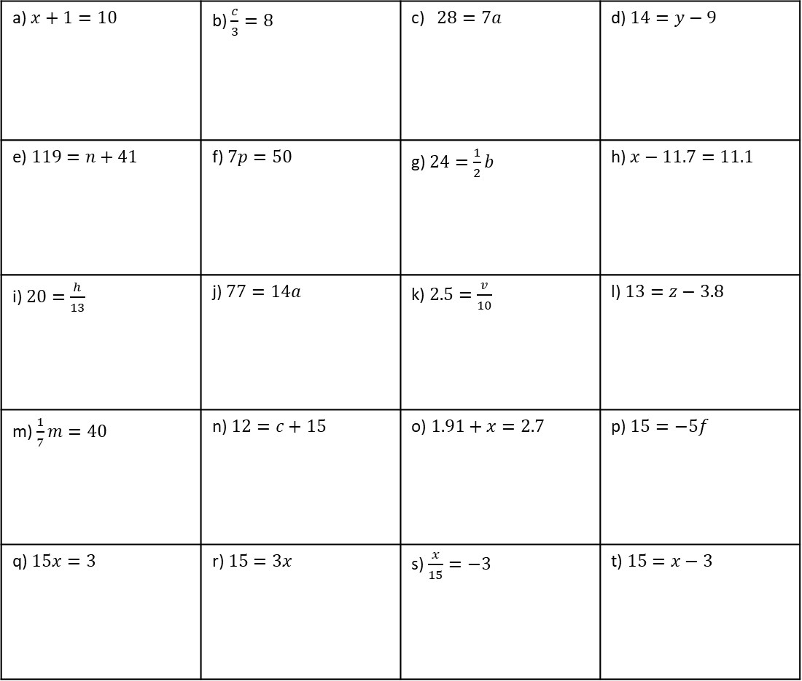
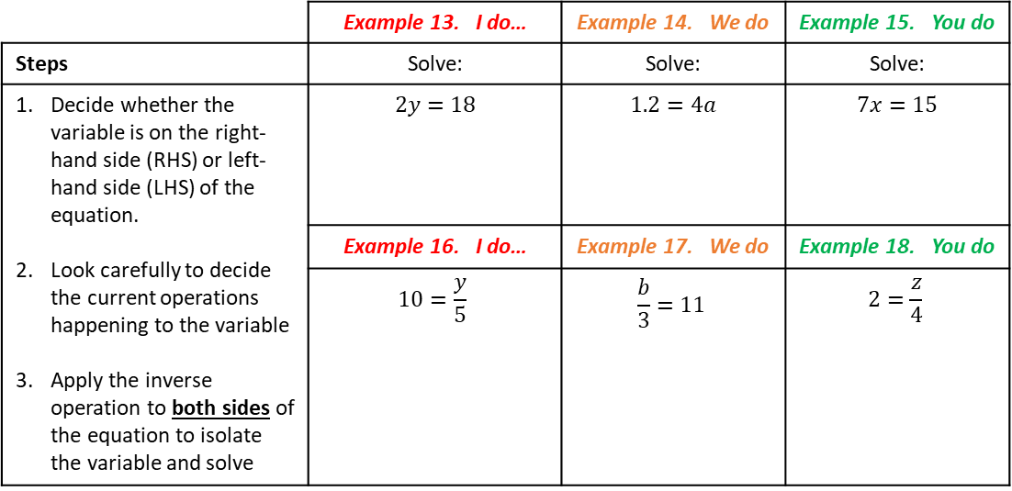
One-Step Equations: Multiplication and Division
 | Example 13. I do… | Example 14. We do | Example 15. You do
Steps | Solve: | Solve: | Solve:
Decide whether the variable is on the right-hand side (RHS) or left-hand side (LHS) of the equation. Look carefully to decide the current operations happening to the variable Apply the inverse operation to both sides of the equation to isolate the variable and solve | $$2y=18$$ | $$1.2=4a$$ | $$7x=15$$
 | Example 16. I do… | Example 17. We do | Example 18. You do
 | $$10=\frac{y}{5}$$ | $$\frac{b}{3}=11$$ | $$2=\frac{z}{4}$$
Mixed Practice
Question 1. Solve each of the equations. Show all your working.
a) $x+1=10$ | b) $\frac{c}{3}=8$ | c) $28=7a$ | d) $14=y−9$
e) $119=n+41$ | f) $7p=50$ | g) $24=\frac{1}{2}b$ | h) $x−11.7=11.1$
i) $20=\frac{h}{13}$ | j) $77=14a$ | k) $2.5=\frac{v}{10}$ | l) $13=z−3.8$
m) $\frac{1}{7}m=40$ | n) $12=c+15$ | o) $1.91+x=2.7$ | p) $15=−5f$
q) $15x=3$ | r) $15=3x$ | s) $\frac{x}{15}=−3$ | t) $15=x−3$

Slide 4
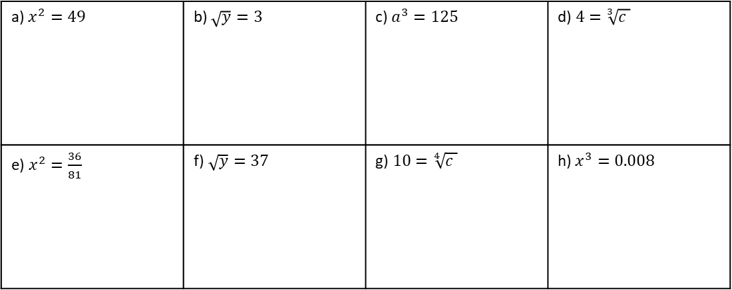
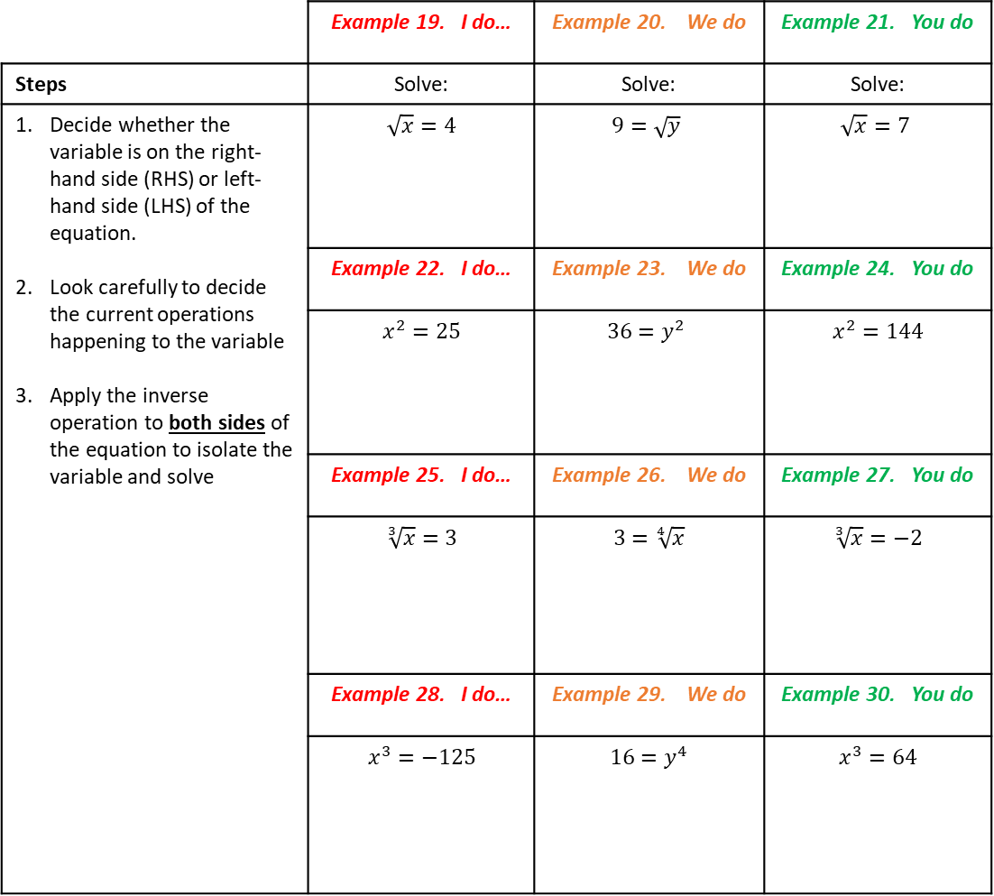
One-Step Equations: Powers and Roots
 | Example 19. I do… | Example 20. We do | Example 21. You do
Steps | Solve: | Solve: | Solve:
Decide whether the variable is on the right-hand side (RHS) or left-hand side (LHS) of the equation. Look carefully to decide the current operations happening to the variable Apply the inverse operation to both sides of the equation to isolate the variable and solve | $$\sqrt{x}=4$$ | $$9=\sqrt{y}$$ | $$\sqrt{x}=7$$
 | Example 22. I do… | Example 23. We do | Example 24. You do
 | $$x^{2}=25$$ | $$36=y^{2}$$ | $$x^{2}=144$$
 | Example 25. I do… | Example 26. We do | Example 27. You do
 | $$\sqrt[3]{x}=3$$ | $$3=\sqrt[4]{x}$$ | $$\sqrt[3]{x}=−2$$
 | Example 28. I do… | Example 29. We do | Example 30. You do
 | $$x^{3}=−125$$ | $$16=y^{4}$$ | $$x^{3}=64$$
Independent Practice
Question 2. Solve each of the equations. Show all your working.
a) $x^{2}=49$ | b) $\sqrt{y}=3$ | c) $a^{3}=125$ | d)$4=\sqrt[3]{c }$
e) $x^{2}=\frac{36}{81}$ | f)$\sqrt{y}=37$ | g)$10=\sqrt[4]{c }$ | h) $x^{3}=0.008$

Slide 5
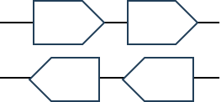
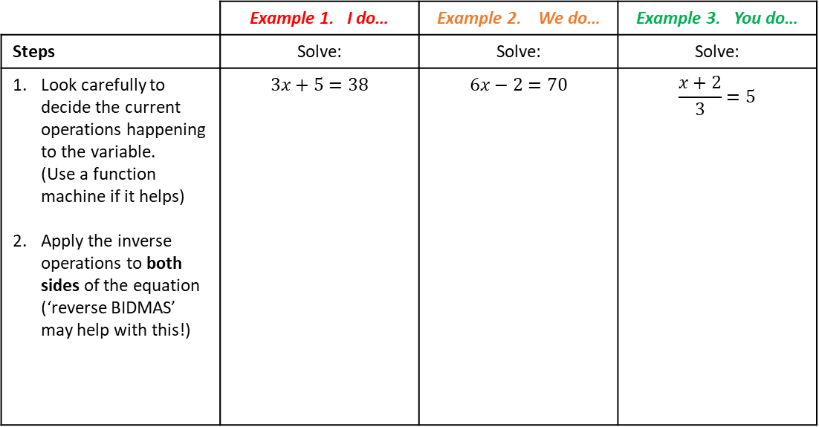
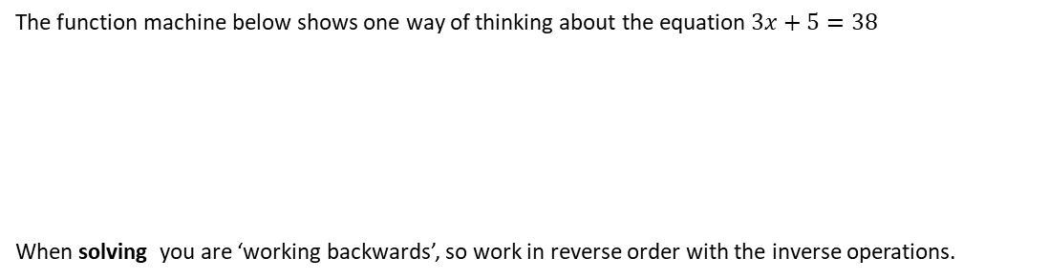
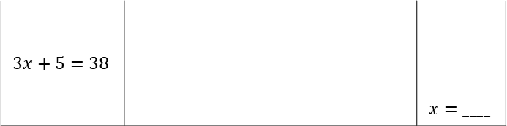
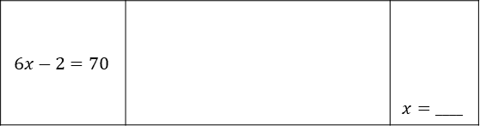
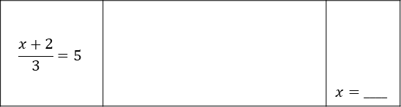
Solving Two-Step Equations
It is helpful to think of solving equations as “working backwards” – you know something has
happened to the variable and you need to work backwards to find its value. This is why we have been
using the inverse operation to isolate the variable.
Often, we will need to do more than one step to solve the equation, so we have to consider the
inverse of multiple operations. You will need to do the steps in the correct order by considering the
order of operations to solve successfully!
I do…
The function machine below shows one way of thinking about the equation $3x+5=38$
When solving you are ‘working backwards’, so work in reverse order with the inverse operations.
$$3x+5=38$$ |  | $$x=____$$
We do… | You do…
$$6x−2=70$$ |  | $$x=____$$
$$\frac{x+2}{3}=5$$ |  | $$x=____$$
As equations get more complex, this is not always the best representation, but the same kind of
thinking can make sure we complete each step in the right order.
Instead, we manipulate the equations themselves, showing the inverse operations being applied to
each side of the “=“ to keep it balanced.
 | Example 1. I do… | Example 2. We do… | Example 3. You do…
Steps | Solve: | Solve: | Solve:
Look carefully to decide the current operations happening to the variable. (Use a function machine if it helps) Apply the inverse operations to both sides of the equation (‘reverse BIDMAS’ may help with this!) | $$3x+5=38$$ | $$6x−2=70$$ | $$\frac{x+2}{3}=5$$

Slide 6
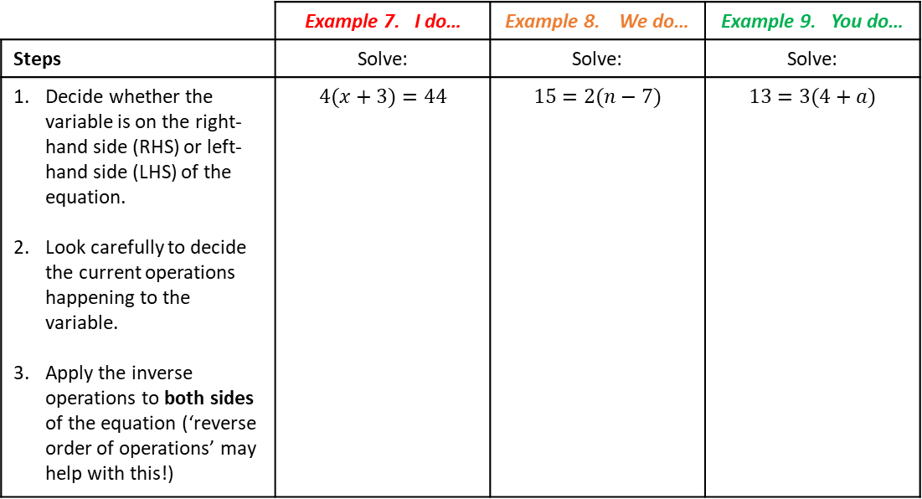
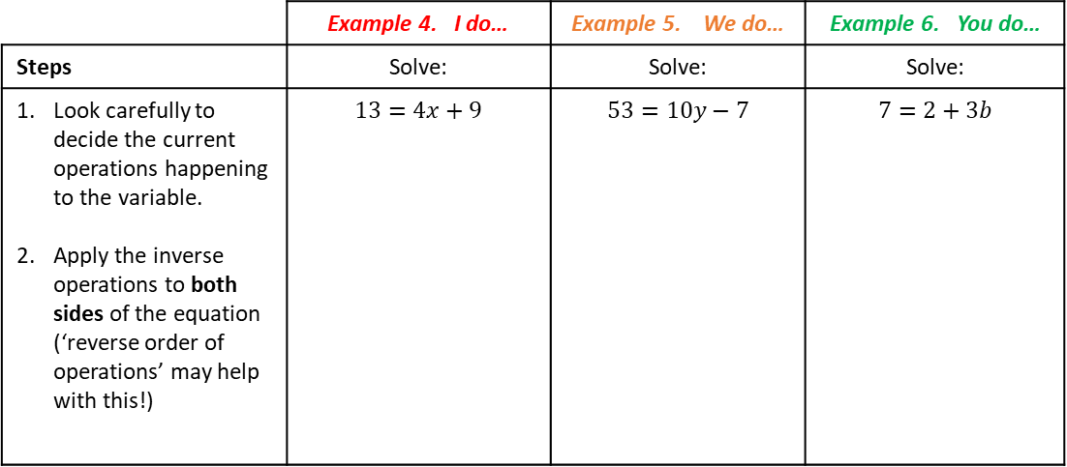
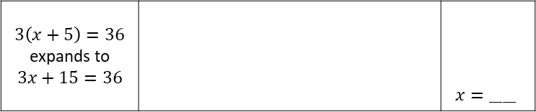
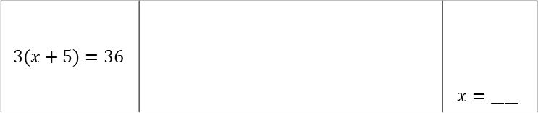
Two-step Equations with Multiplication
 | Example 4. I do… | Example 5. We do… | Example 6. You do…
Steps | Solve: | Solve: | Solve:
Look carefully to decide the current operations happening to the variable. Apply the inverse operations to both sides of the equation (‘reverse order of operations’ may help with this!) | $$13=4x+9$$ | $$53=10y−7$$ | $$7=2+3b$$
Two-step Equations with Brackets
Equations involving brackets can be solved using the order of operations.
Or we can expand the brackets and solve as above.
$$3(x+5)=36$$ |  | $$x=____$$
$$3\left(x+5\right)=36$$ expands to $$3x+15=36$$ |  | $$x=____$$
 | Example 7. I do… | Example 8. We do… | Example 9. You do…
Steps | Solve: | Solve: | Solve:
Decide whether the variable is on the right-hand side (RHS) or left-hand side (LHS) of the equation. Look carefully to decide the current operations happening to the variable. Apply the inverse operations to both sides of the equation (‘reverse order of operations’ may help with this!) | $$4(x+3)=44$$ | $$15=2(n−7)$$ | $$13=3(4+a)$$

Slide 7
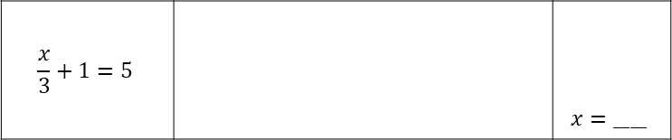
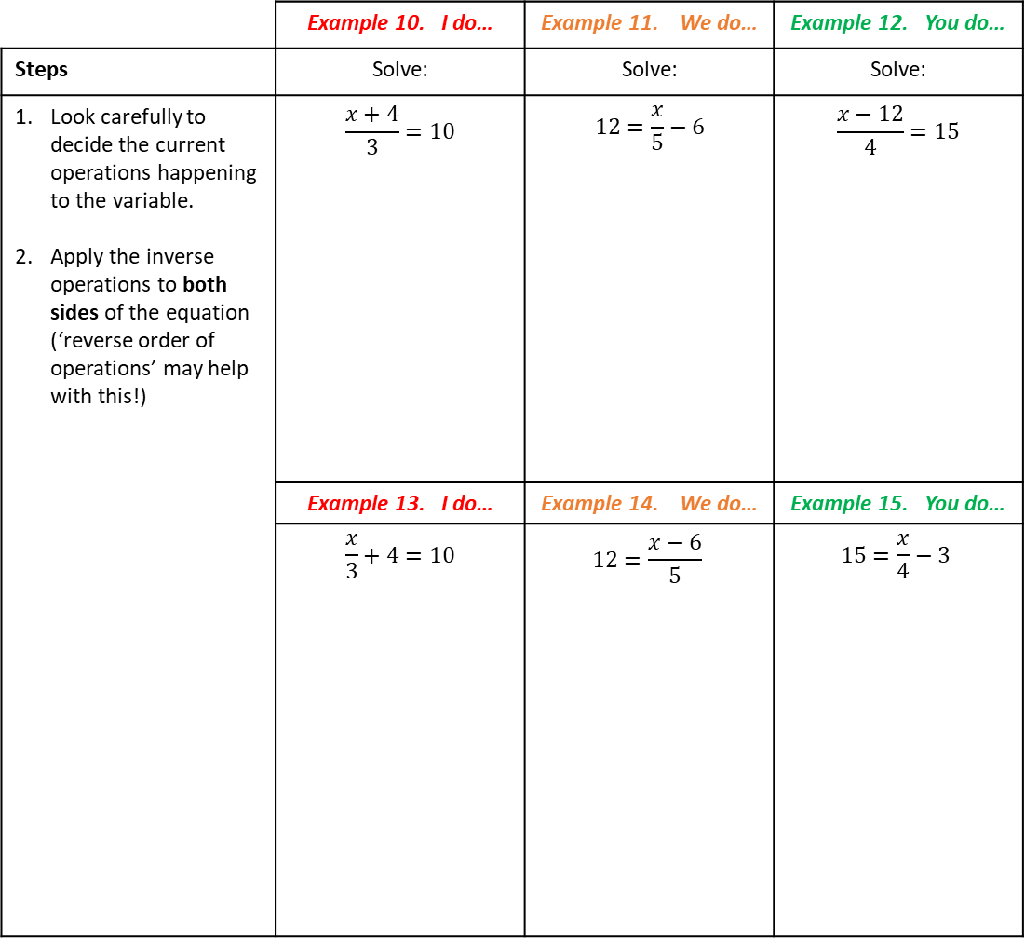
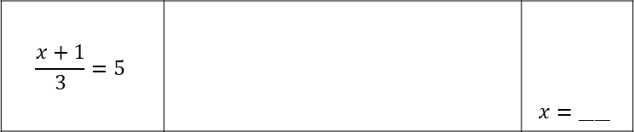
Two-step Equations with Division
Equations with divisions also need careful consideration for the order of operations.
These two equations look very similar, but the division occurs at a different stage for each!
This affects the order of the inverse operations used to isolate the variable.
$$\frac{x}{3}+1=5$$ |  | $$x=____$$
$$\frac{x+1}{3}=5$$ |  | $$x=____$$
 | Example 10. I do… | Example 11. We do… | Example 12. You do…
Steps | Solve: | Solve: | Solve:
Look carefully to decide the current operations happening to the variable. Apply the inverse operations to both sides of the equation (‘reverse order of operations’ may help with this!) | $$\frac{x+4}{3}=10$$ | $$12=\frac{x}{5}−6$$ | $$\frac{x−12}{4}=15$$
 | Example 13. I do… | Example 14. We do… | Example 15. You do…
 | $$\frac{x}{3}+4=10$$ | $$12=\frac{x−6}{5}$$ | $$15=\frac{x}{4}−3$$

Slide 8
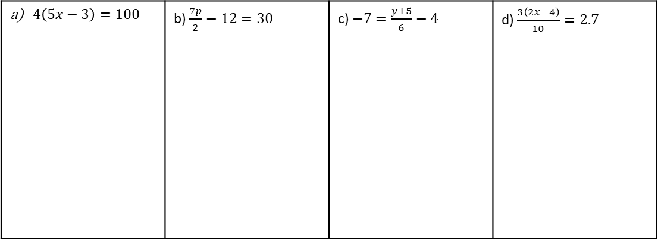
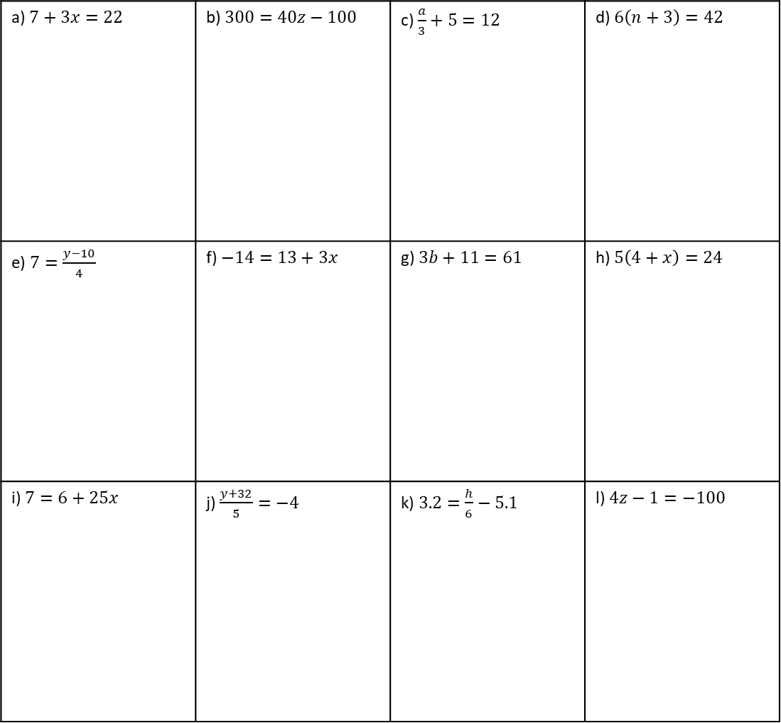
Mixed Practice
Question 3. Solve each of the equations. Show all your working.
a) $7+3x=22$ | b) $300=40z−100$ | c) $\frac{a}{3}+5=12$ | d) $6\left(n+3\right)=42$
e) $7=\frac{y−10}{4}$ | f) $−14=13+3x$ | g) $3b+11=61$ | h) $5\left(4+x\right)=24$
i) $7=6+25x$ | j) $\frac{y+32}{5}=−4$ | k) $3.2=\frac{h}{6}−5.1$ | l) $4z−1=−100$
Challenge – More than Two Steps
Question 4. Solve each of the equations. Show all your working.
$4\left(5x−3\right)=100$ | b) $\frac{7p}{2}−12=30$ | c) $−7=\frac{y+5}{6}−4$ | d) $\frac{3\left(2x−4\right)}{10}=2.7$

Slide 9
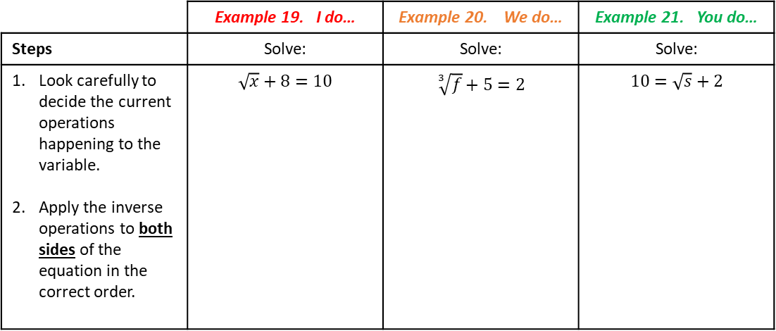
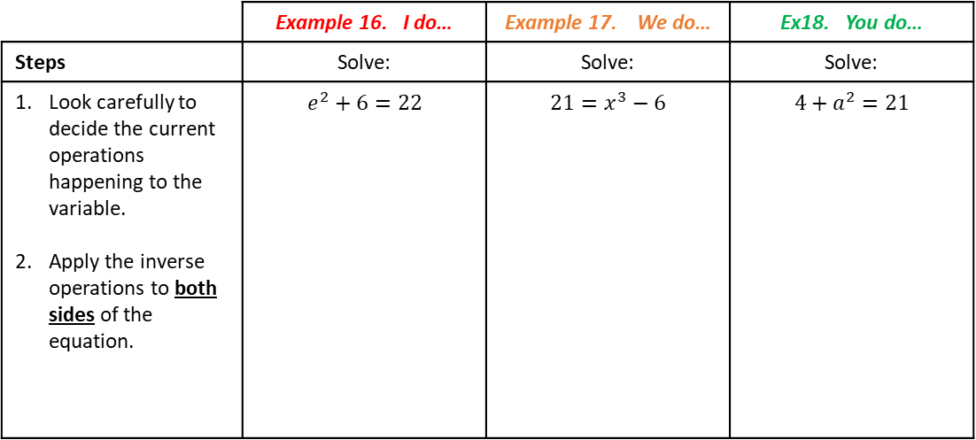
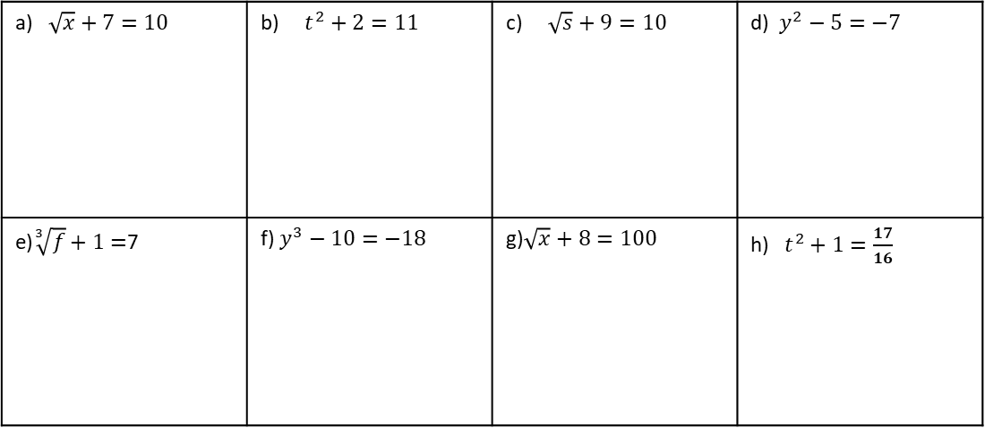
Two-step Equations with Powers
 | Example 16. I do… | Example 17. We do… | Ex18. You do…
Steps | Solve: | Solve: | Solve:
Look carefully to decide the current operations happening to the variable. Apply the inverse operations to both sides of the equation. | $$e^{2}+6=22$$ | $${21=x}^{3}−6$$ | $${4+a}^{2}=21$$
Two-step Equations with Roots
 | Example 19. I do… | Example 20. We do… | Example 21. You do…
Steps | Solve: | Solve: | Solve:
Look carefully to decide the current operations happening to the variable. Apply the inverse operations to both sides of the equation in the correct order. | $$\sqrt{x}+8=10$$ | $$\sqrt[3]{f}+5=2$$ | $$10=\sqrt{s}+2$$
Independent Practice
Question 5. Solve each of the equations. Show all your working.
a) $\sqrt{x}+7=10$ | b) $t^{2}+2=11$ | c) $\sqrt{s}+9=10$ | d) $y^{2}−5=−7$
e)$\sqrt[3]{f}+1=$7 | f) $y^{3}−10=−18$ | g)$\sqrt{x}+8=100$ | h) $t^{2}+1=\frac{17}{16}$

Slide 10
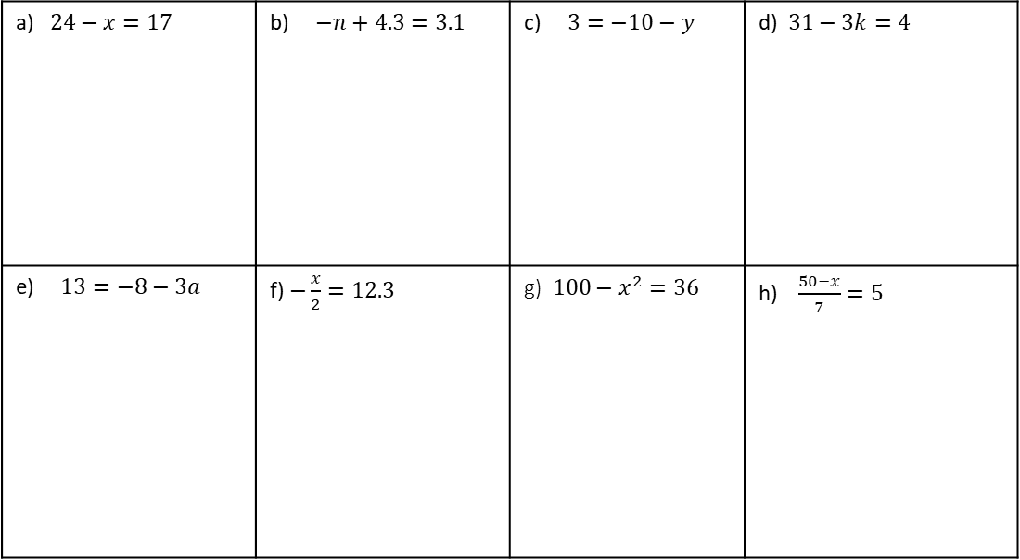

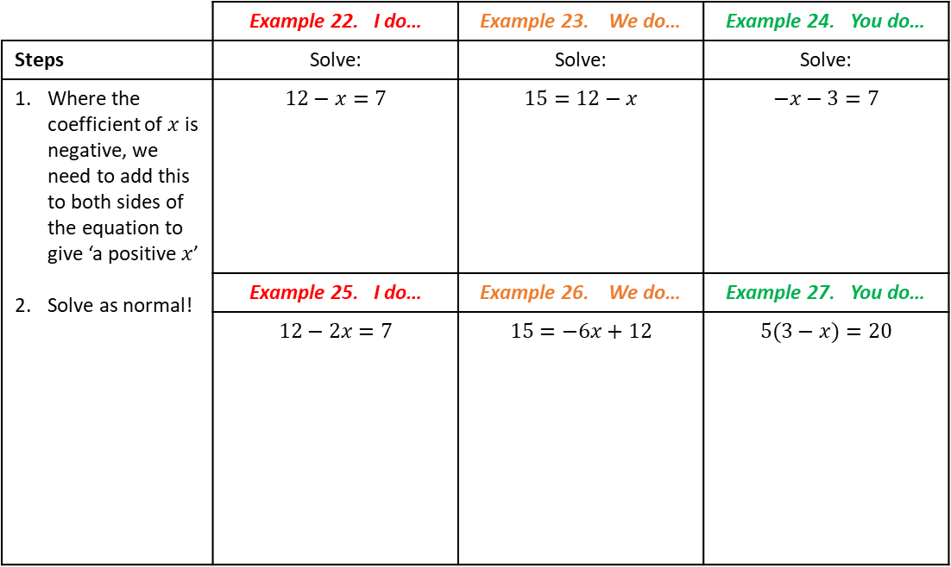



Equations with Negative Coefficients
Freya thinks she has solved the equation below. She is incorrect. Can you explain why?
$$10−x=4$$
$$−10$$
$$−10$$
$$x=−6$$
Where there are negative coefficients of a variable, we need to be careful to isolate the positive
variable. The easiest & most reliable way to do so is to add the positive equivalent to each side to
create an equation more like those we have solved so far.
 | Example 22. I do… | Example 23. We do… | Example 24. You do…
Steps | Solve: | Solve: | Solve:
Where the coefficient of $x$ is negative, we need to add this to both sides of the equation to give ‘a positive $x$’ Solve as normal! | $$12−x=7$$ | $$15=12−x$$ | $$−x−3=7$$
 | Example 25. I do… | Example 26. We do… | Example 27. You do…
 | $$12−2x=7$$ | $$15=−6x+12$$ | $$5(3−x)=20$$
Independent Practice
Question 6. Solve each of the equations. Show all your working.
a) $24−x=17$ | b) $−n+4.3=3.1$ | c) $3=−10−y$ | d) $31−3k=4$
e) $13=−8−3a$ | f) $−\frac{x}{2}=12.3$ | g)$100−x^{2}=36$ | h)$\frac{50−x}{7}=5$

Slide 11
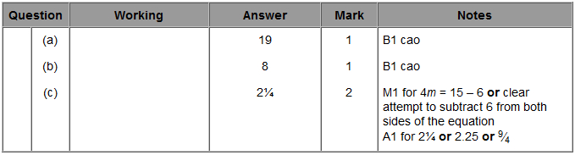
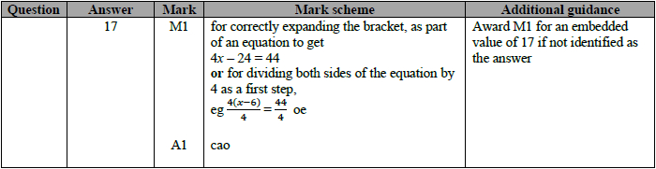

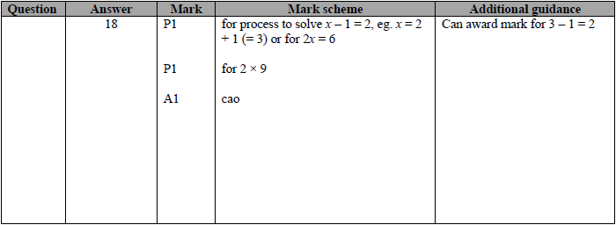
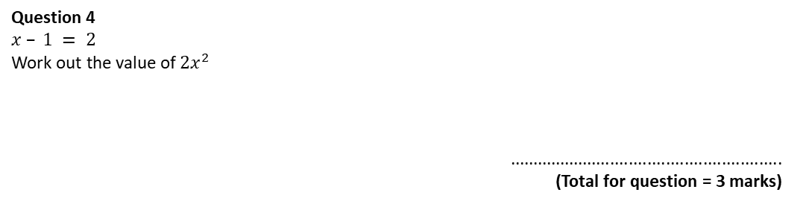

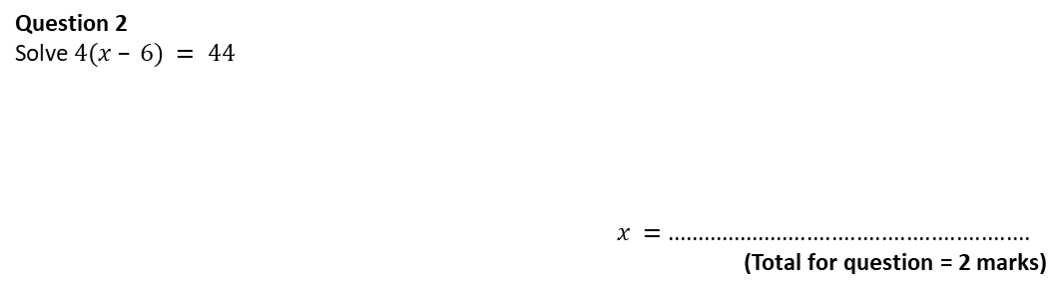

Exam Questions
Question 1
Solve $b – 7 = 12$
$b =$. . . . . . . . . . . . . . . . . . . . . . . . . .
(1)
(b) Solve $5e = 40$
$e =$. . . . . . . . . . . . . . . . . . . . . . . . . .
(1)
(c) Solve $4m + 6 = 15$
$m =$. . . . . . . . . . . . . . . . . . . . . . . . . .
(2)
Question 2
Solve$4(x – 6) = 44$
$x =$ ...........................................................
(Total for question = 2 marks)
Question 3
(a) Solve $3m = 36$
$m =$...........................................................
(1)
(b) Solve $7 – x = 3$
$x =$...........................................................
(1)
Question 4
$$x – 1 = 2$$
Work out the value of $2x^{2}$
...........................................................
(Total for question = 3 marks)

Slide 12
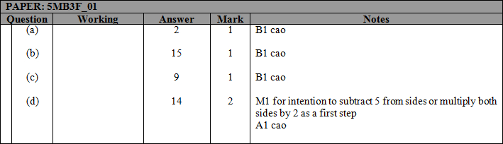

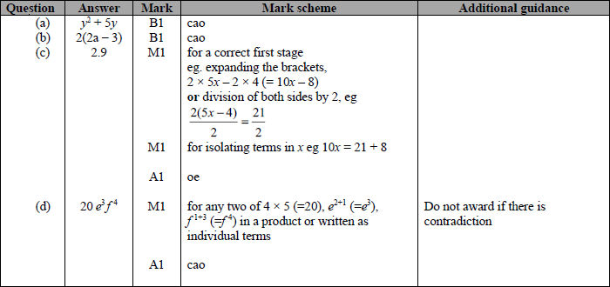
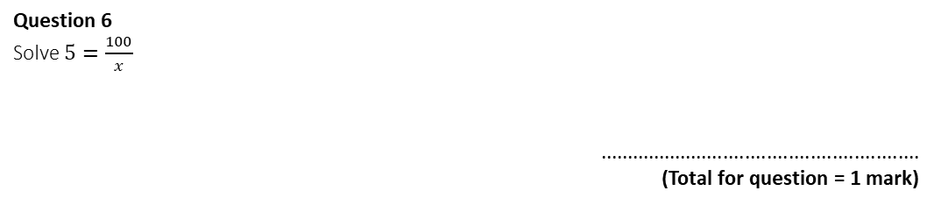


Question 5
(a) Solve $x + x + x = 6$
$x =$...........................................................
(1)
(b) Solve $t + 5 = 20$
$t =$...........................................................
(1)
(c) Solve $4y = 36$
$y =$...........................................................
(1)
(d) Solve $\frac{1}{2}f + 5 = 12$
$f =$...........................................................
(2)
Question 6
Solve $5=\frac{100}{x}$
...........................................................
(Total for question = 1 mark)
Question 7
Expand$y\left(y + 5\right)$
...........................................................
(1)
Factorise $4a−6$
...........................................................
(1)
(c) Solve$2(5x – 4) = 21$
$x =$...........................................................
(3)
(d) Simplify $4e^{2}f×5ef^{3}$
...........................................................
(1)

Slide 13
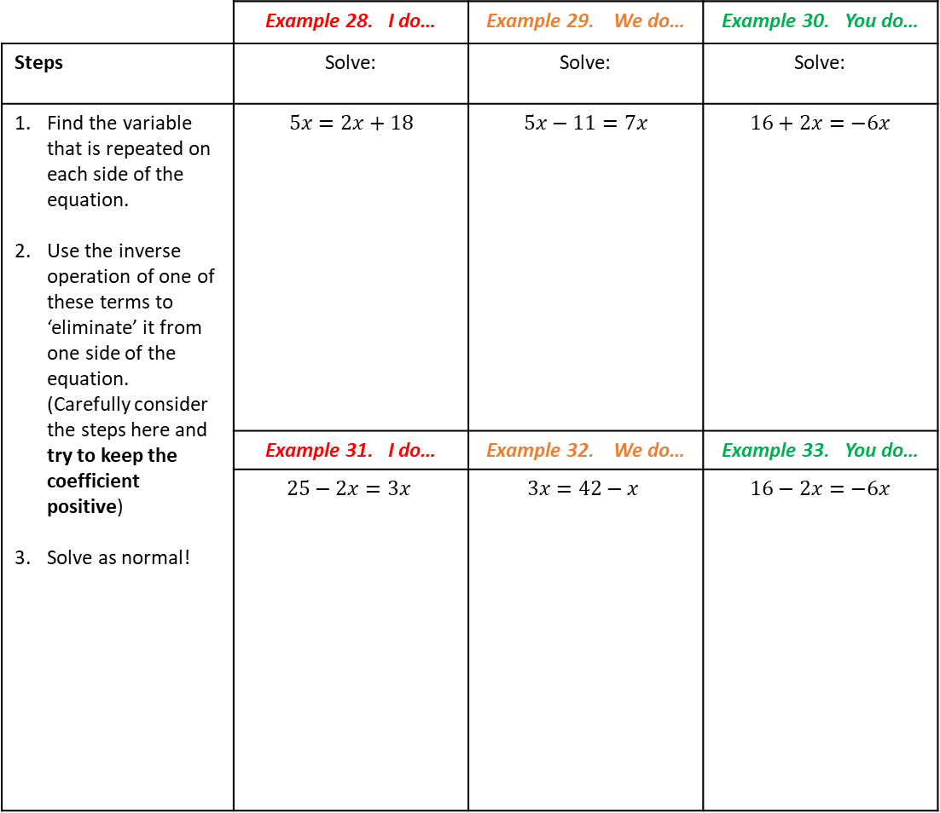
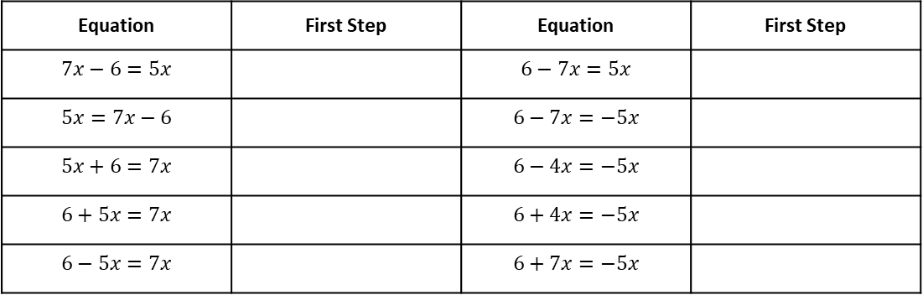
Subtopic 1B: Equations with Unknowns on Both Sides
Sometimes an equation will not be equal to a given constant, but instead equal to another
expression.
We still want to isolate the variable to create an equation more like those we have solved previously,
but we also need to eliminate it on one side of the equation to give the value of the variable.
 | Example 28. I do… | Example 29. We do… | Example 30. You do…
Steps | Solve: | Solve: | Solve:
Find the variable that is repeated on each side of the equation. Use the inverse operation of one of these terms to ‘eliminate’ it from one side of the equation. (Carefully consider the steps here and try to keep the coefficient positive) Solve as normal! | $$5x=2x+18$$ | $$5x−11=7x$$ | $$16+2x=−6x$$
 | Example 31. I do… | Example 32. We do… | Example 33. You do…
 | $$25−2x=3x$$ | $$3x=42−x$$ | $$16−2x=−6x$$
Does it matter which ‘$x$’ term I eliminate?
For each of the below, describe the most efficient first step.
Equation | First Step | Equation | First Step
$$7x−6=5x$$ |  | $$6−7x=5x$$
$$5x=7x−6$$ |  | $$6−7x=−5x$$
$$5x+6=7x$$ |  | $$6−4x=−5x$$
$$6+5x=7x$$ |  | $$6+4x=−5x$$
$$6−5x=7x$$ |  | $$6+7x=−5x$$

Slide 14
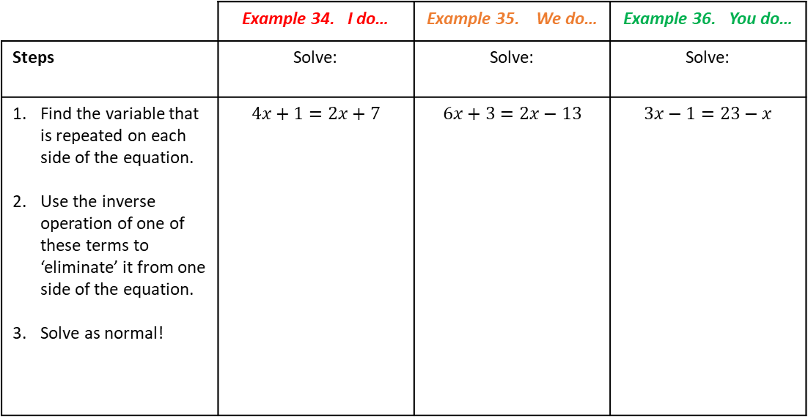
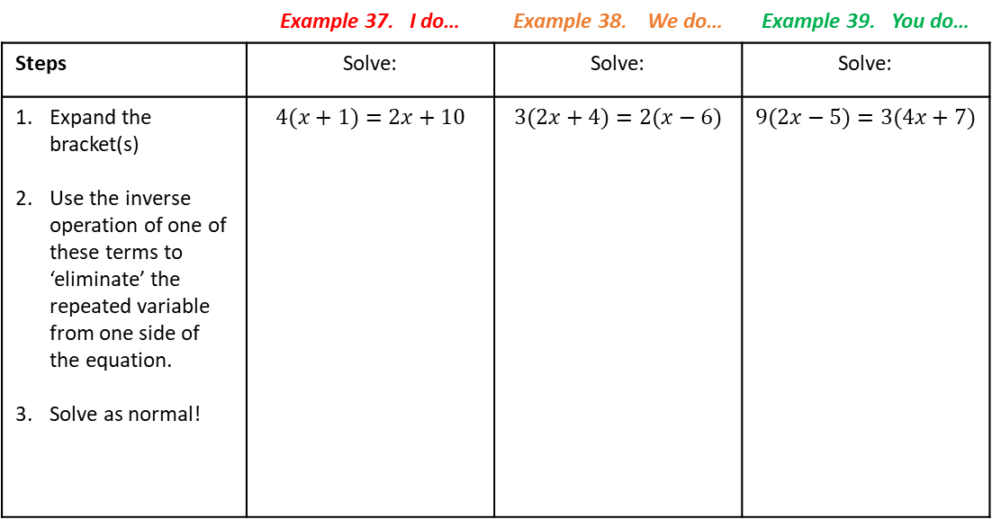
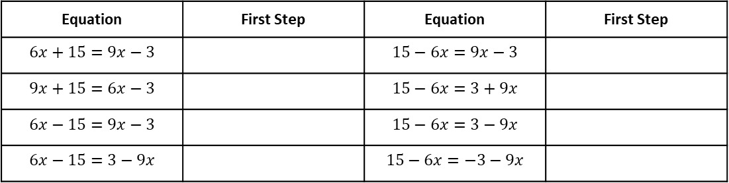
 | Example 34. I do… | Example 35. We do… | Example 36. You do…
Steps | Solve: | Solve: | Solve:
Find the variable that is repeated on each side of the equation. Use the inverse operation of one of these terms to ‘eliminate’ it from one side of the equation. Solve as normal! | $$4x+1=2x+7$$ | $$6x+3=2x−13$$ | $$3x−1=23−x$$
Does it matter which ‘$x$’ term I eliminate?
For each of the below, describe the most efficient first step.
Equation | First Step | Equation | First Step
$$6x+15=9x−3$$ |  | $$15−6x=9x−3$$
$$9x+15=6x−3$$ |  | $$15−6x=3+9x$$
$$6x−15=9x−3$$ |  | $$15−6x=3−9x$$
$$6x−15=3−9x$$ |  | $$15−6x=−3−9x$$
Equations with Unknowns on Both Sides & Brackets
 | Example 37. I do… | Example 38. We do… | Example 39. You do…
Steps | Solve: | Solve: | Solve:
Expand the bracket(s) Use the inverse operation of one of these terms to ‘eliminate’ the repeated variable from one side of the equation. Solve as normal! | $$4(x+1)=2x+10$$ | $$3(2x+4)=2(x−6)$$ | $$9(2x−5)=3(4x+7)$$

Slide 15
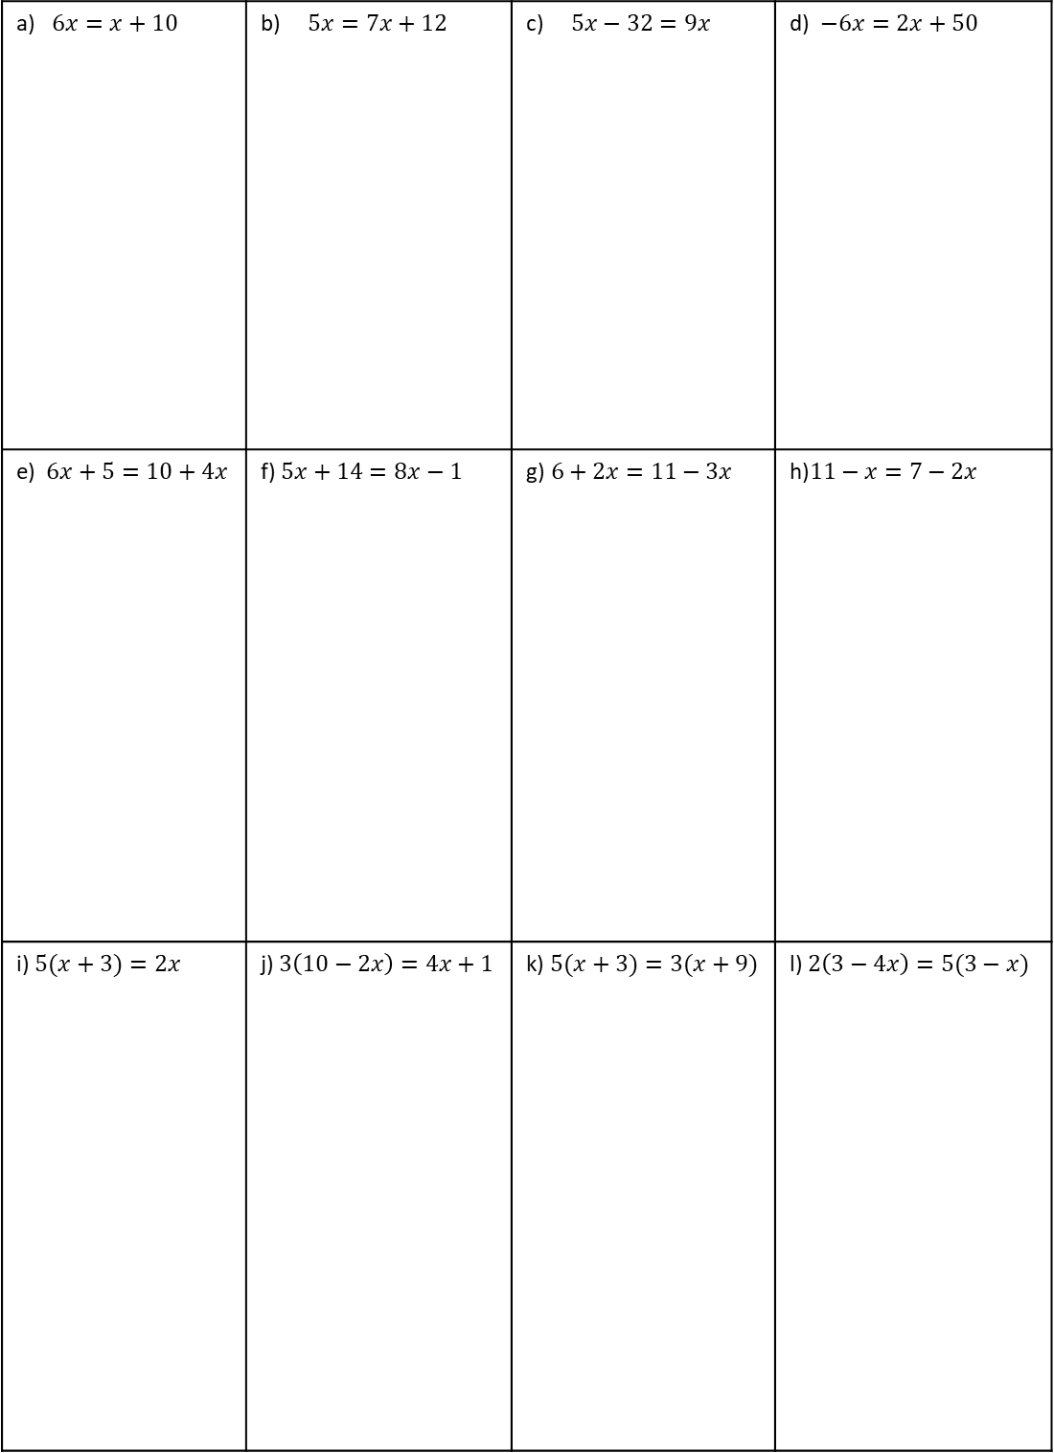
Independent Practice
Question 7. Solve each of the equations. Show all your working.
a) $6x=x+10$ | b) $5x=7x+12$ | c) $5x−32=9x$ | d) $−6x=2x+50$
e) $6x+5=10+4x$ | f) $5x+14=8x−1$ | g)$6+2x=11−3x$ | h)$11−x=7−2x$
i) $5(x+3)=2x$ | j) $3\left(10−2x\right)=4x+1$ | k) $5(x+3)=3(x+9)$ | l) $2\left(3−4x\right)=5(3−x)$

Slide 16
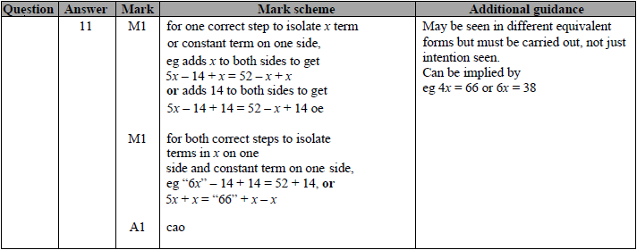
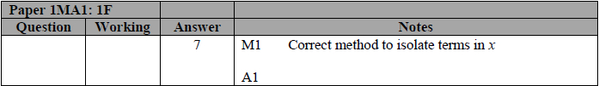









Exam Questions
Question 1
Solve$4x + 5 = x + 26$
$x =$...........................................................
(Total for question = 2 marks)
Question 5 Solve
Question 2
Solve $5x − 14 = 52 − x$
$x =$...........................................................
(Total for question = 3 marks)
Question 3
Solve $5x – 6 = 3(x – 1)$
$x =$...........................................................
(Total for question = 3 marks)
Question 4
Solve $4(x + 3) = 2(x + 4)$
$x =$...........................................................
(Total for question = 3 marks)
$$\frac{5−x}{2}=2x−7$$
$x=$...........................................................
(Total for question = 3 marks)

